Slide 1
GO Canada – Geomagnetic Data Integration
Space Apps Challenge – Canadian Space Agency

Slide 2

Workshop Plan
The description of Earth’s magnetic field, datasets, context of this challenge and the importance of monitoring geomagnetic activity.
The description of the Canada Geospatial Observatory (GO Canada)
The main problems related to the use of geomagnetic data
First problem: Parasitic magnetic fields
Second problem: The low density of measurement sites
Proposed solutions to the GO Canada Challenge
Identify parasitic magnetic fields.
Description of the proposed solution
Example of a dataset
Mapping Canadian geomagnetic activity
Description of the solution
Link to the first solution proposal
Example of a dataset

Slide 3

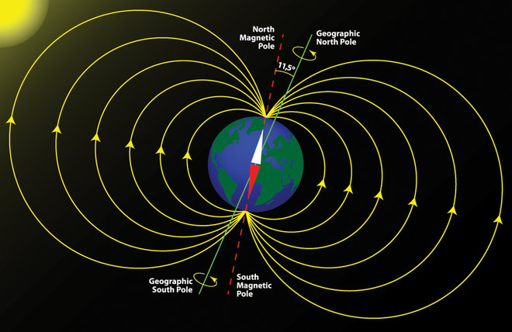
Generated by the convection movements in Earth’s outer core, containing iron and nickel, two ferromagnetic elements.
SI unit : tesla
Amplitude between 25 microteslas (equator) and 65 microteslas (magnetic poles)
Inclined with respect to the Earth's axis of rotation
https://www.livescience.com/21668-why-earth-magnetic-field-wonky.html

Slide 4

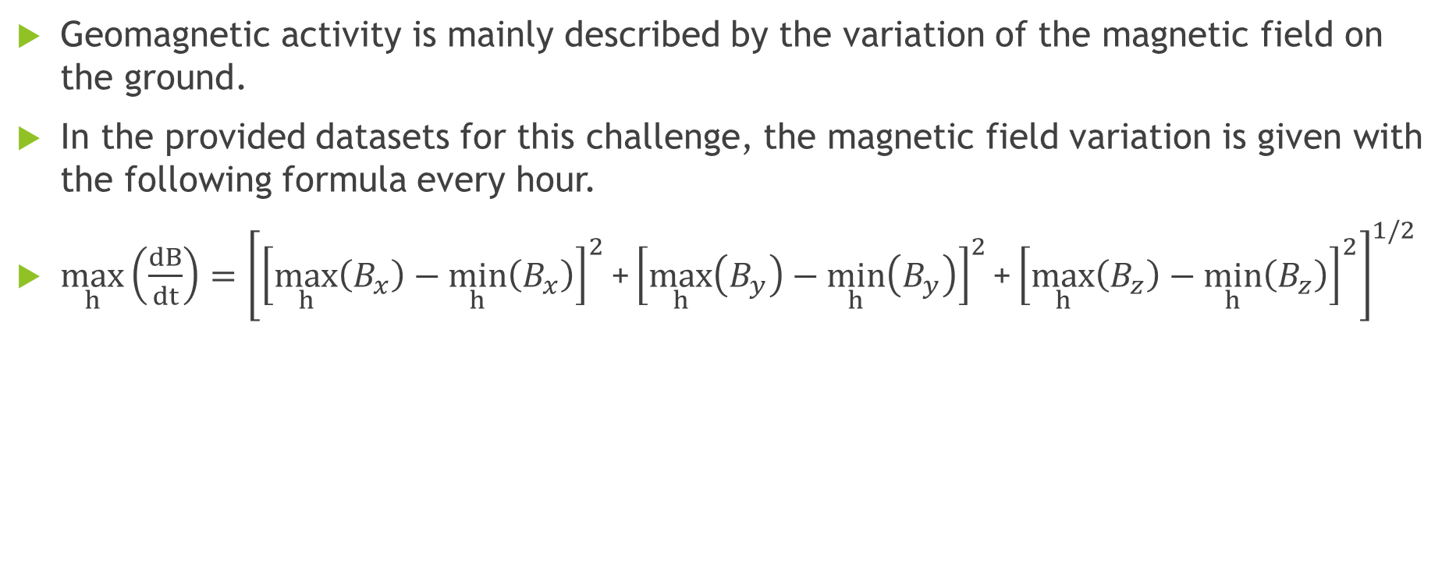

Slide 5
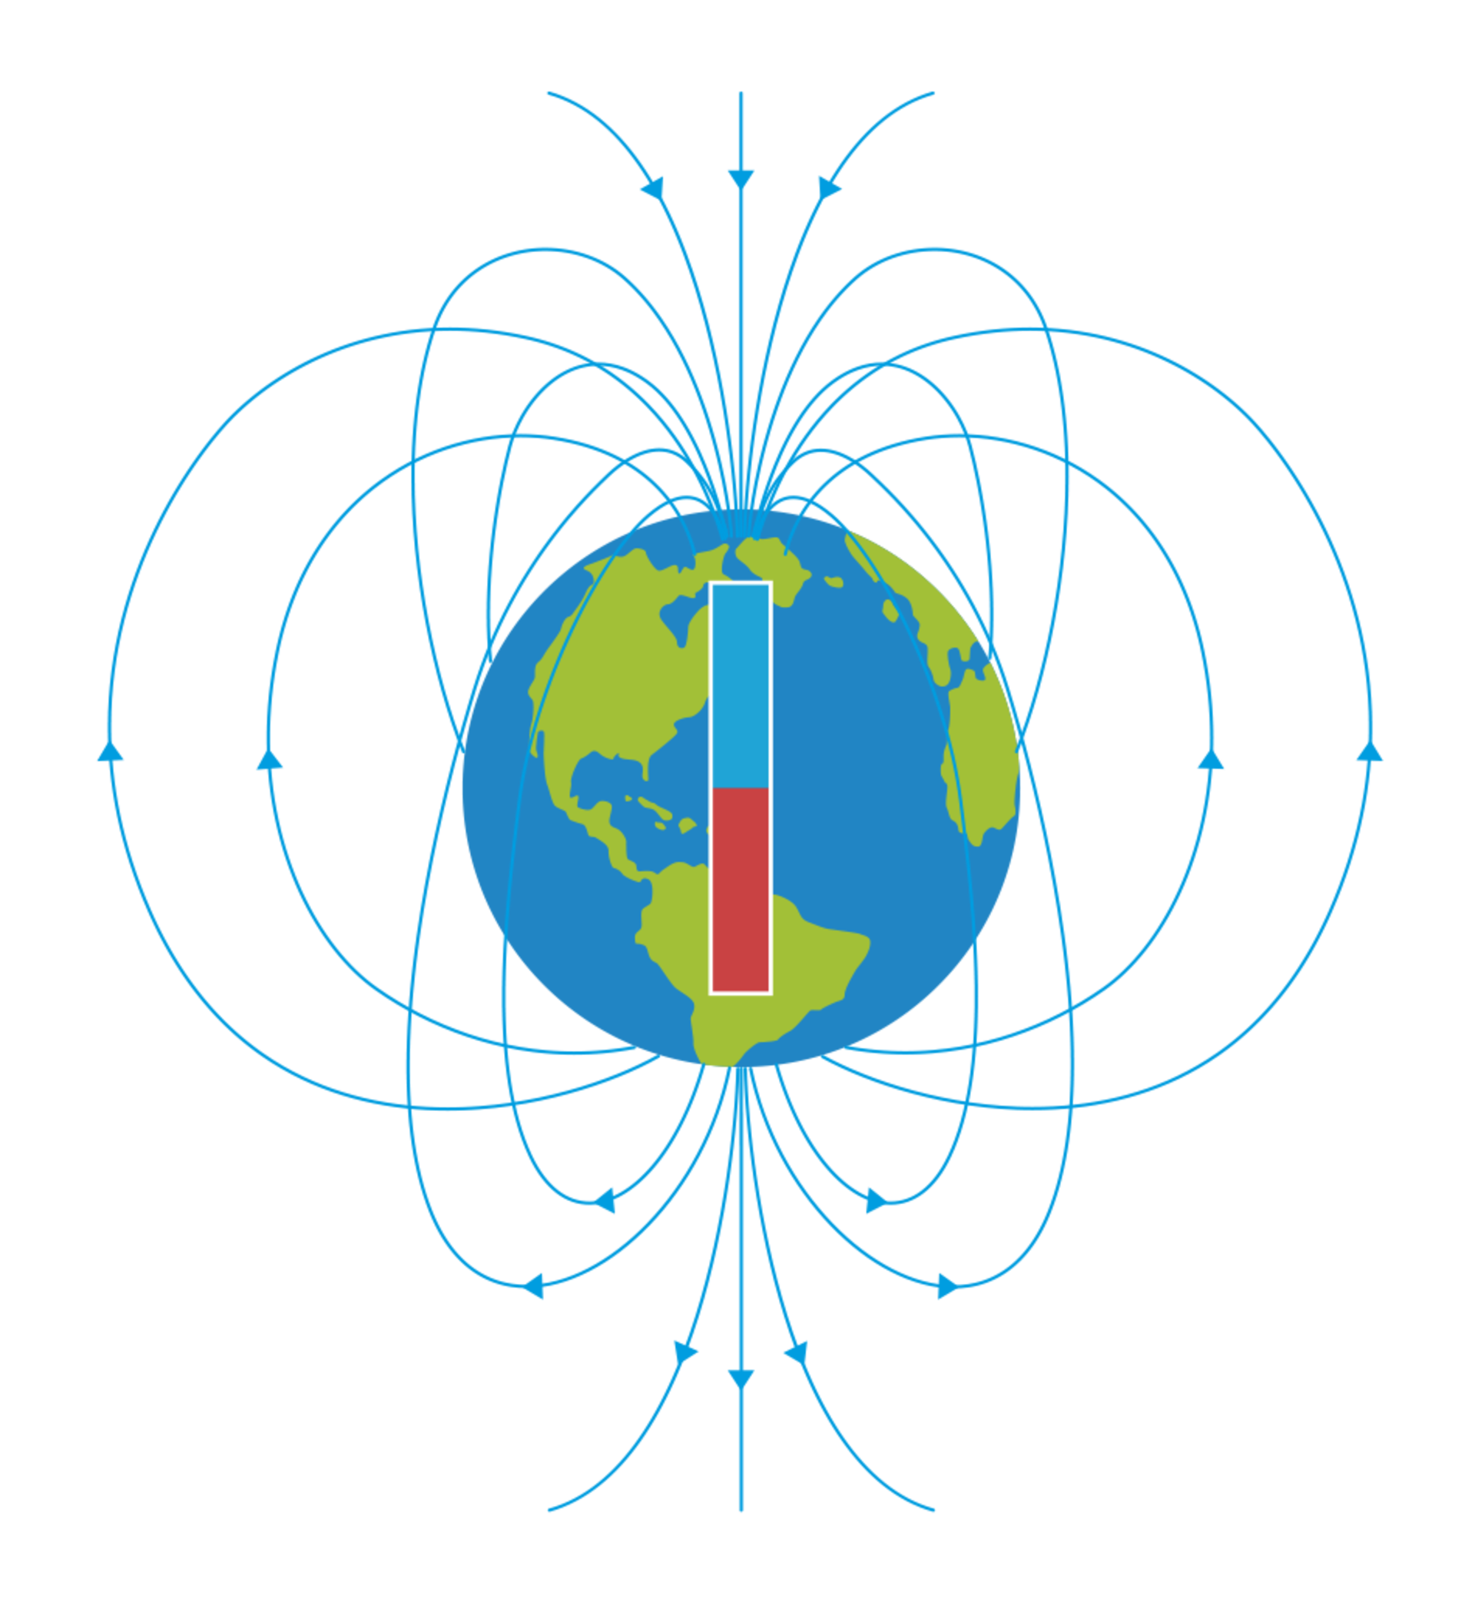
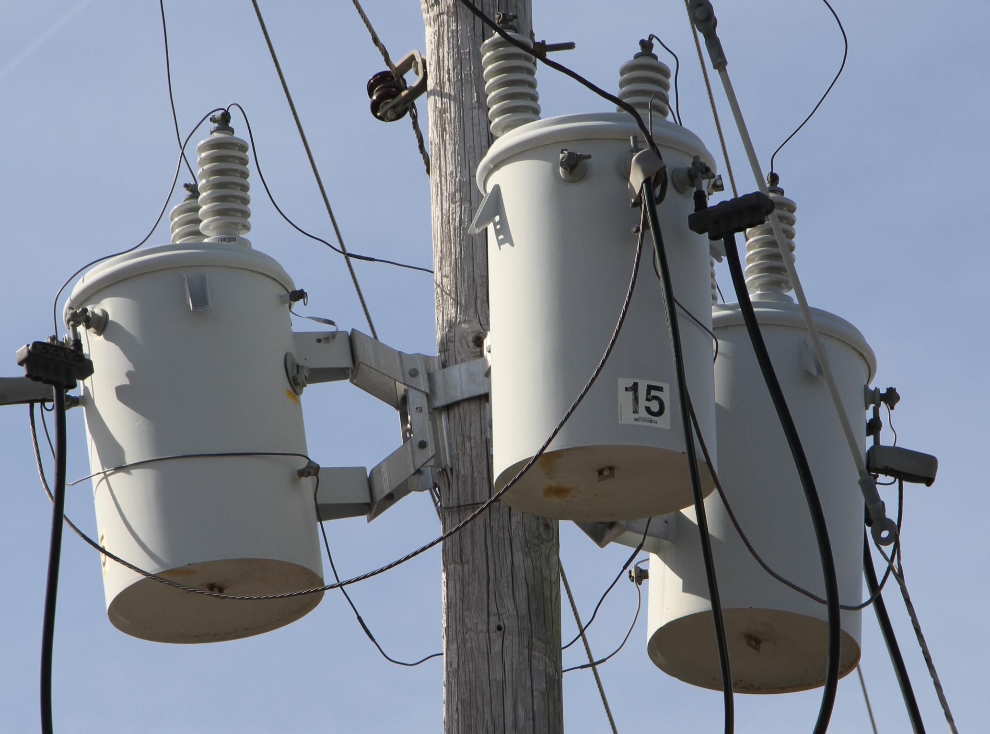
Context
It is essential to monitor geomagnetic activity because of the geomagnetically induced currents (GICs) caused by large variations in the Earth's magnetic field, themselves caused by solar storms.
These currents can cause considerable damage to electrical transformers and thus cause power failures on a very large scale.
https://metglas.com/distribution-transformer-electrical-steel/three-white-distribution-transformers-on-pole-with-light-blue-sky/
https://www.dkfindout.com/uk/earth/structure-earth/earths-magnetic-field/

Slide 6
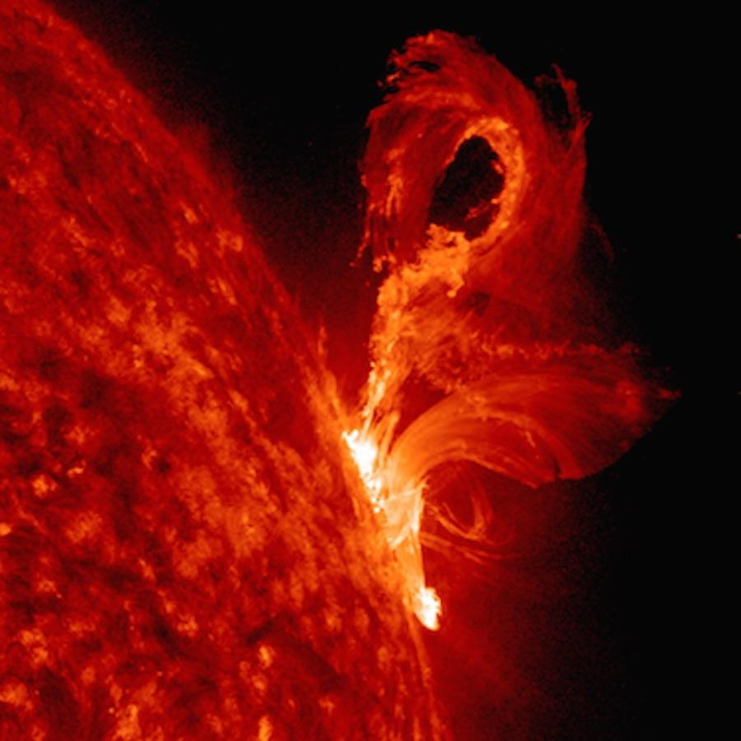
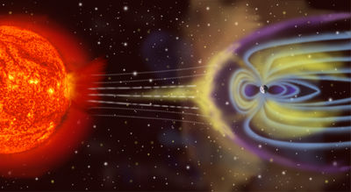
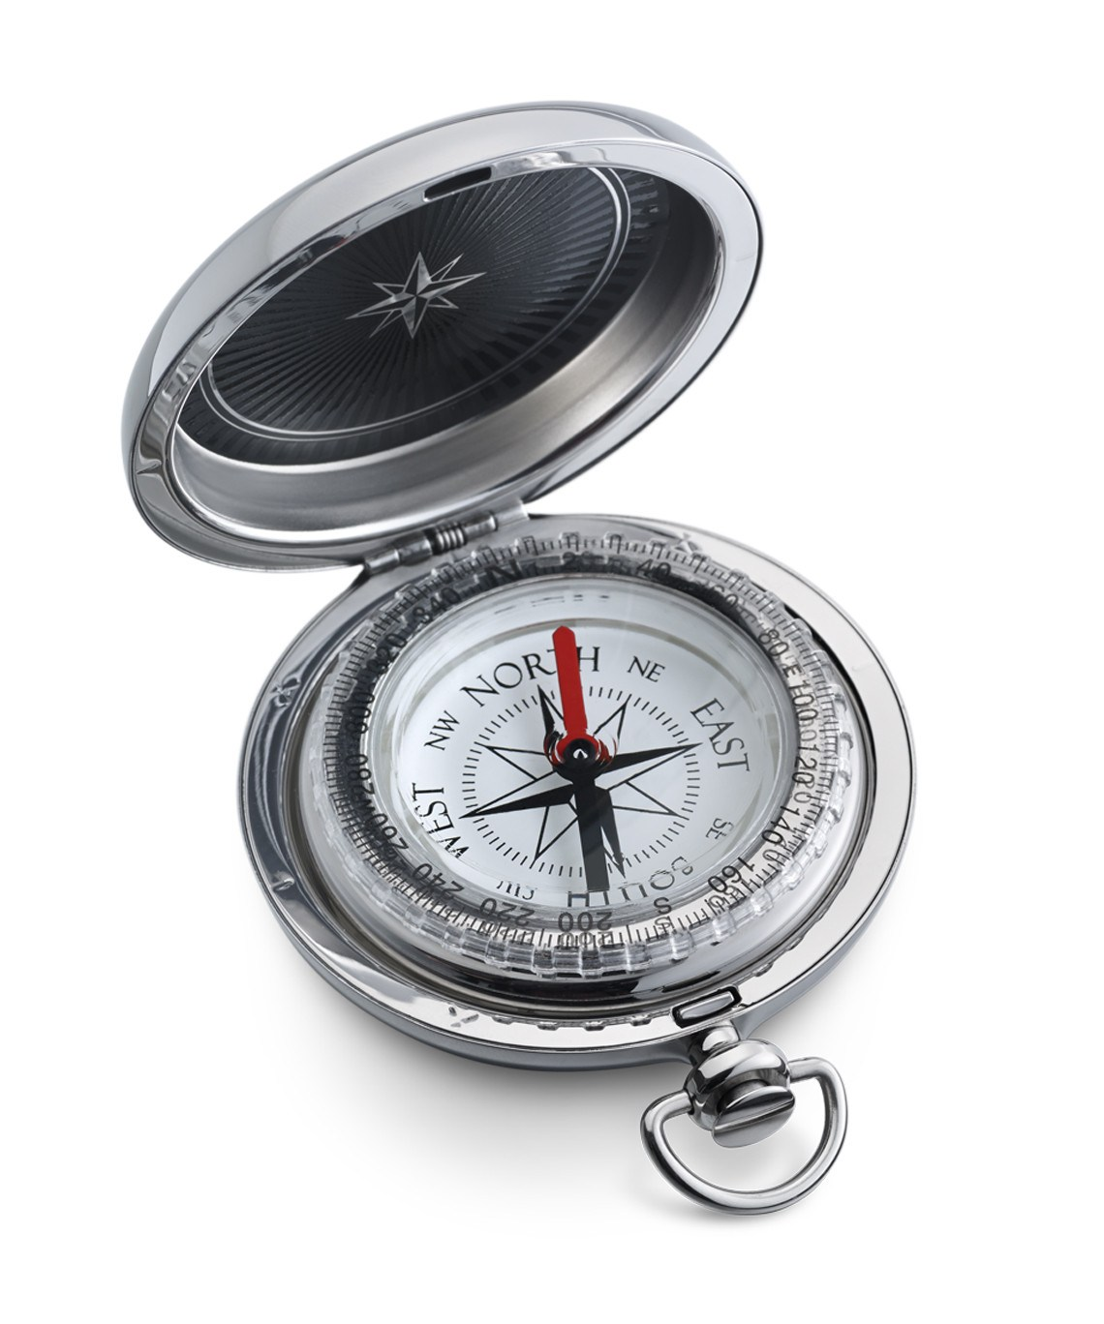
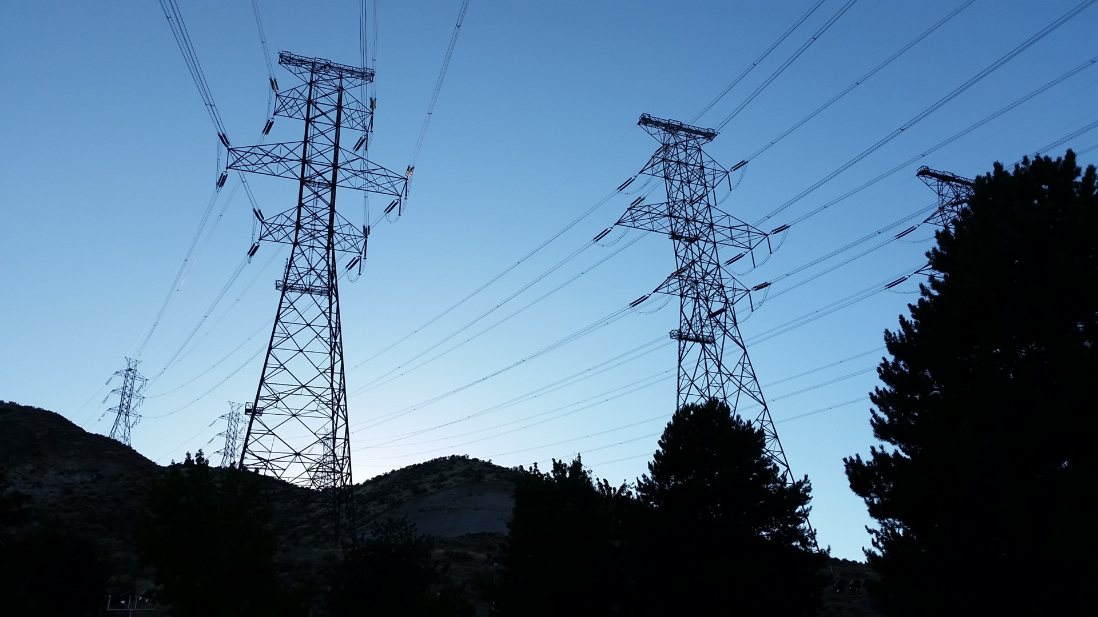
Why Monitor Geomagnetism?
https://cosmosmagazine.com/society/how-a-solar-flare-nearly-triggered-a-nuclear-war
https://en.wikipedia.org/wiki/Geomagnetic_storm
https://www.dalvey.com/ca/sport-compass-71003
A solar flare propels a huge amount of energy particles towards Earth.
This plasma interacts with Earth’s magnetic field, acting as a sheild.
This interaction causes significant variations in Earth's magnetic field.
https://www.sciencemag.org/news/2016/01/better-power-lines-would-help-us-supercharge-renewable-energy-study-suggests
https://metglas.com/distribution-transformer-electrical-steel/three-white-distribution-transformers-on-pole-with-light-blue-sky/
Large current peaks are caused in the transformers, which triggers their protection mechanisms rendering them inoperative.
These magnetic field variations cause large currents (GICs) in high voltage lines.

Slide 7
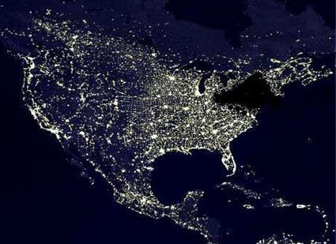
Major Power Outages
The major power outage of August 14, 2003
https://owlcation.com/misc/The-Great-Northeast-Blackout-of-2003

Slide 8
GO Canada
The Canadian Geospatial Observatory (GO Canada) is an initiative of the Canadian Space Agency in collaboration with Natural Resources Canada (NRCAN) and a few Canadian universities to monitor and analyze impacts related to space weather across the country.
GO Canada has more than 60 ground sites, each of them using a variety of instruments to collect data and images to better understand and monitor space weather.
Among these instruments are magnetometers that continuously and precisely measure the magnetic field in three dimensions.
Solar storms result in large variations in the Earth's magnetic field and are therefore measured by these magnetometers.

Slide 9
Problems with the Magnetometer Network
There are 2 main problems with the use of these magnetometers:
The false geomagnetic fluctuations
The low density of measuring instruments.
The two challenge propositions are derived from these issues

Slide 10
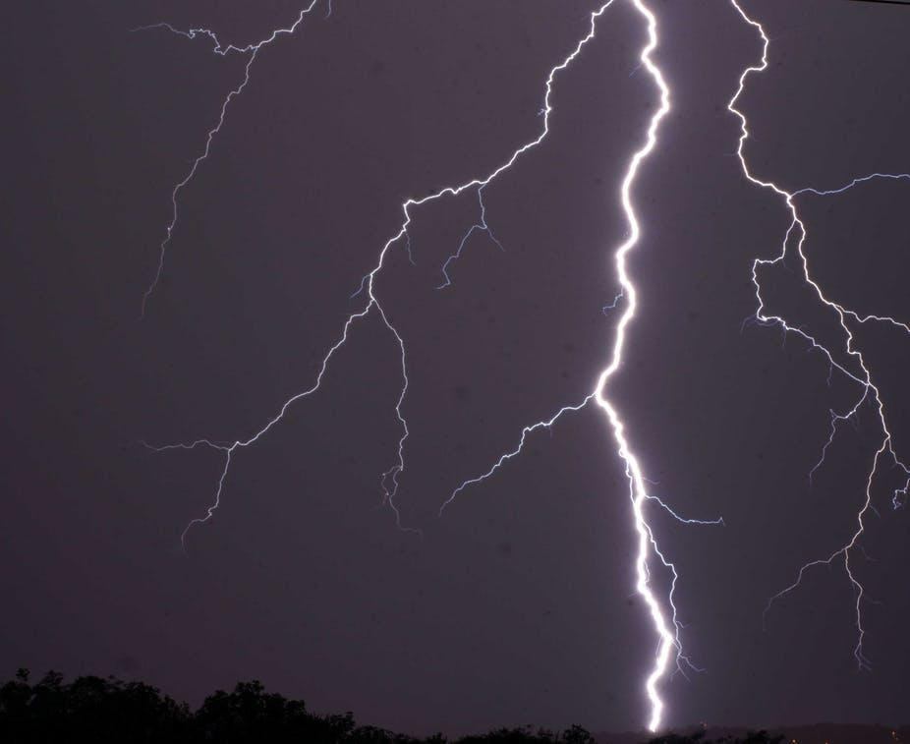
False geomagnetic fluctuations
Causes :
Human activity in the vicinity
Thunderstorms / Lightning
Instrument failure
Instrument overheating
Power failure of the site
Data transmission problem

Slide 11
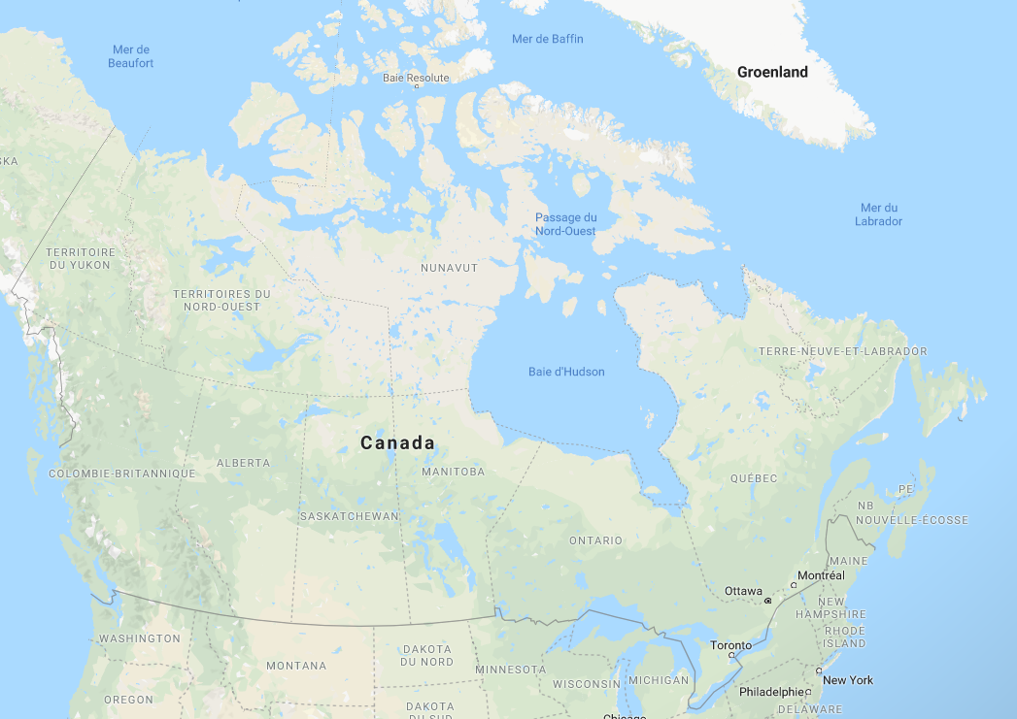
Low density of measuring instruments
?
It is difficult to estimate geomagnetic activity at some locations due to the low density of measurement sites
?
?
?
https://www.google.com/maps/@57.8759466,-107.4402377,4.34z
Fictional magnetometer site

Slide 12
Challenge Proposition #1 : Identify parasitic magnetic fields
Objective: Create a script that identifies parasitic geomagnetic activity and assigns a degree of reliability based on a suggested value to the erroneous data.
Process: The dataset1.txt (181 KB) file is provided to participants for this challenge. It contains magnetic variation data from 26 measurement sites over 31 days in one-hour increments. Participants must create a script that reports the falsified data in a report.
Final Product: Participants must present their report of the data deemed geomagnetically implausible, including location, time (DD-HH) and reliability of the aforementioned measurement. The format of this report is left to the discretion of the participants.
Evaluation: Participants will be judged according to the following criteria
The number of false error predictions
The number of actual error predictions
The degree of reliability attributed to errors / The suggestion for error replacement
Ease of understanding and use of the minutes
Accessibility of the report format.

Slide 13
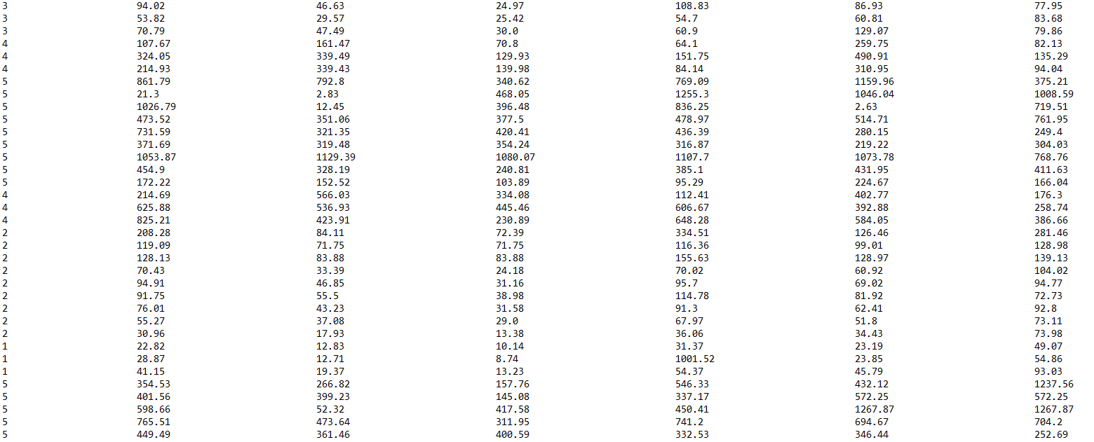
Dataset - Proposition #1
Example :
The magnetic variation of these two sites is drastically different
The magnetic variation of these two sites is different than the other sites at this time

Slide 14
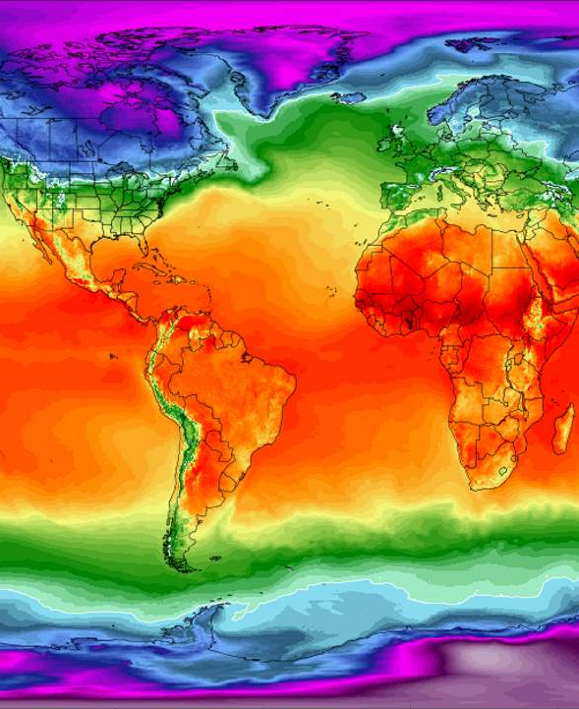
Challenge Proposition #2: Mapping the variation of the Earth's magnetic field
Objective: Create a script to estimate the variation in magnetic field at a measurement site where the data is erroneous/lost.
Process: The files dataset2_full.txt (117 KB) and dataset2_holed.txt (116 KB) are available to participants for this challenge. The objective of the participants is to estimate the magnetic field variations for the missing site. They will be able to use the dataset2_full.txt dataset to measure the accuracy of different mapping methods.
Final product: Participants must submit a text file (.txt) containing the estimate of magnetic field variations over the given period as well as a visual representation of the geomagnetic mapping (image/video).
Evaluation: Participants will be judged according to the following criteria
The accuracy of their estimate
The quality of the mapping (visual support)
The originality and ingenuity of the method used.
https://ourplnt.com/climate-reanalyzer-visual-climate-weather-datasets/climate-reanalyzer-world-temperature-map/

Slide 15
Challenge
Ficitonal GO Canada magnetometer site
To be able to quantify the quality of the estimations, a whole months worth of data from one site has been removed from the dataset. This simulates data loss or unreliability (Solution proposition #1)
https://www.google.com/maps/@57.8759466,-107.4402377,4.34z

Slide 16
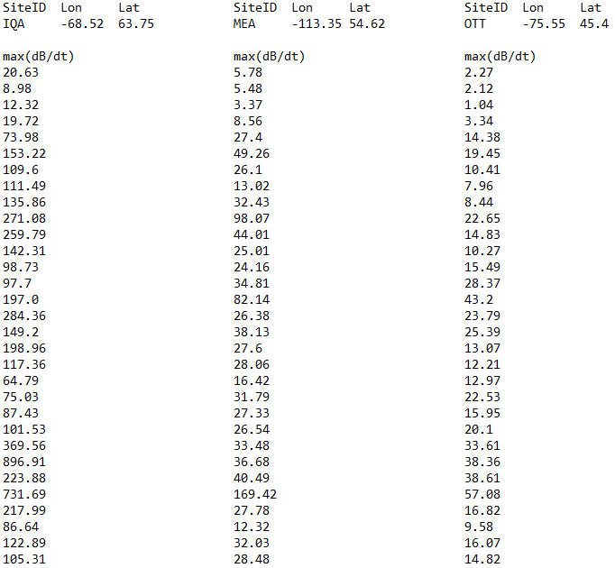
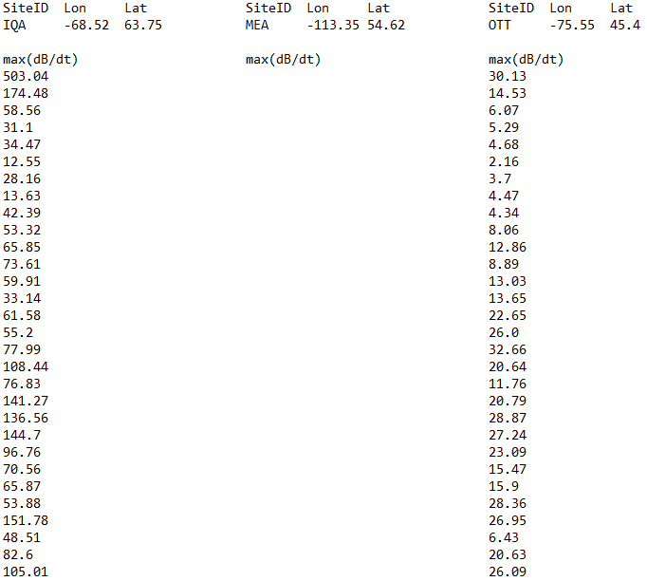
Dataset- Proposition #2
Missing data to be estimated
Dataset2_full.txt
Dataset2_holed.txt

Slide 17
Questions
Challenge Statement document :
Slack

Slide 18
Thank you and Good Luck !

